Slide 1
Lecture 12 Recursion

Slide 2
Outline
Introduction to Recursion
Principles of Recursion
Tail Recursion

Slide 3
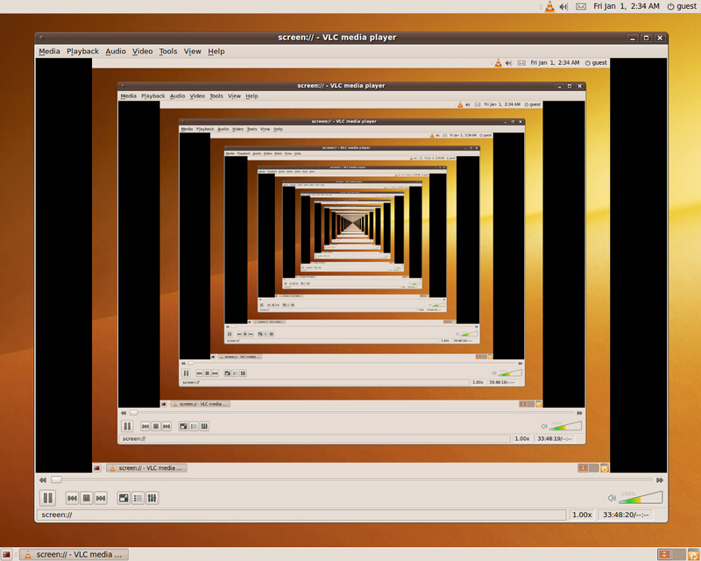
Definition
An algorithm is recursive if it calls itself (directly or indirectly) to do part of its work.
递归是一种描述和解决问题的基本方法，用来解决可归纳描述的问题，或说可分解为结构自相似的问题。所谓结构自相似，是指构成问题的部分与问题本身在结构上相似。

Slide 4

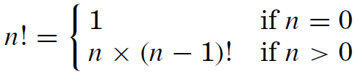
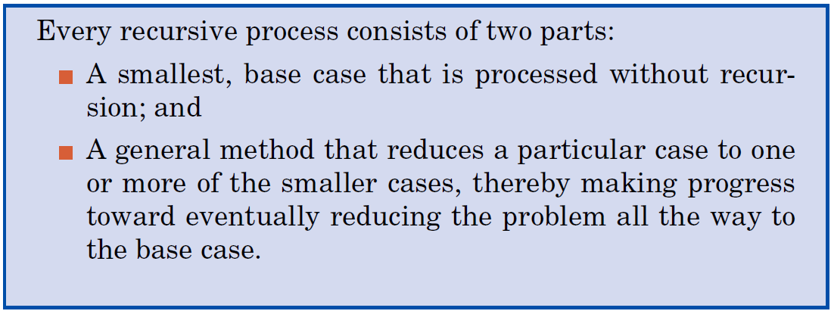
Factorials: A Recursive Definition
The factorial function of a positive integer n is
Recursive definition:

Slide 5
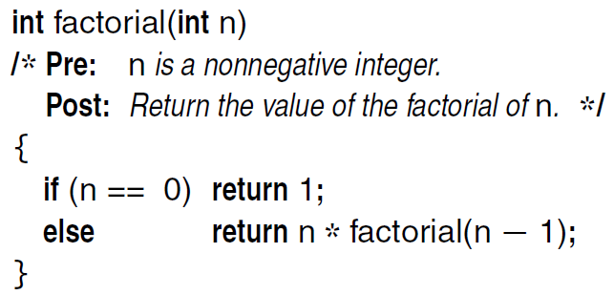
Factorials: A Recursive Definition
Advantage: the recursive definition and recursive solution of a problem can be both concise and elegant
Disadvantage: the computational details can require keeping track of many partial computations before the process is complete.

Slide 6
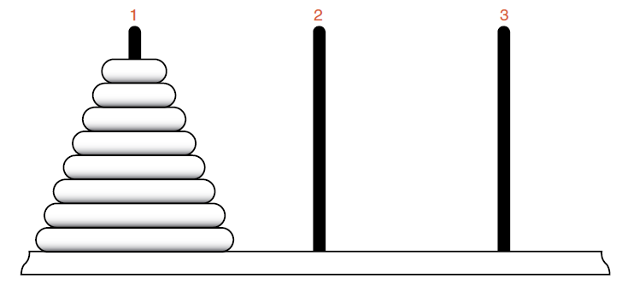
Example: Towers of Hanoi
Task: Move the disks from Tower 1 to Tower 3 using Tower 2 as temporary storage.
Rules:
Move only one disk at a time.
No larger disk can be on top of a smaller disk.

Slide 7
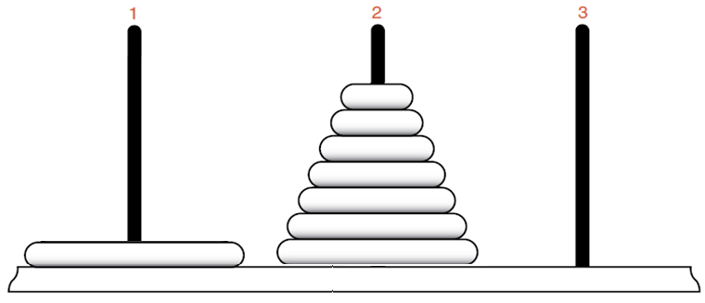
Example: Towers of Hanoi
We have to get to this state and then move the bottom disk from Tower 1 to Tower 3.
Movement of disks in Tower 2 form a similar problem with smaller problem size.

Slide 8
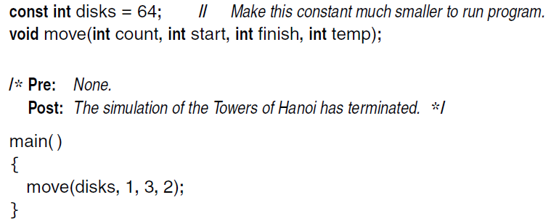
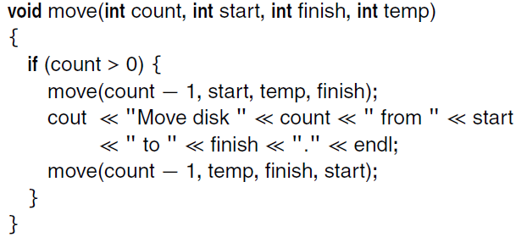
Program for Hanoi

Slide 9
Designing Recursive Algorithms
Find the key steps
Find a stopping rule
Outline your algorithm
Check termination
Draw a recursion tree

Slide 10
Tree of Function Calls (函数调用树)
Tree of function calls is a tool to analyzing the process of function calls.
A node denotes a function call with the function name;
A function may invokes other functions, which are denoted as children;
Different recursive calls appear as different vertices with the same name;
Recursion tree: the recursive part of the tree of function calls.

Slide 11
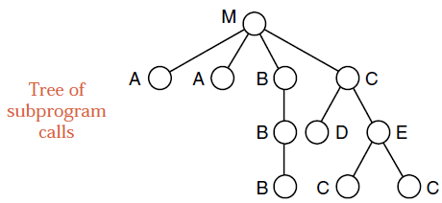
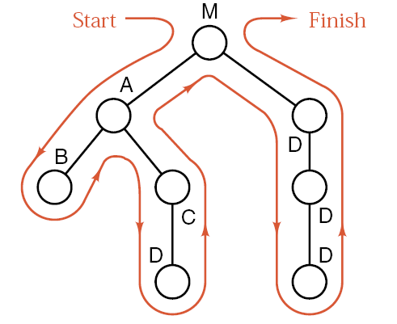
Tree of Function Calls and Execution Order
Recursive call
Execution order

Slide 12
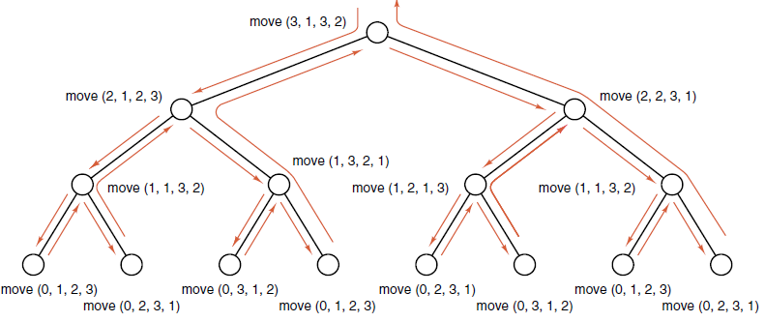
Recursion Tree for Hanoi Tower
From the recursion tree above we can get the number of moves (the number of inner vertices) to solve Hanoi for 64 disks: 1+2+2²+ … +2⁶³ = 2⁶⁴ – 1 ≈ 1.6 × 10¹⁹
Number of nodes is the number of disk movements.

Slide 13
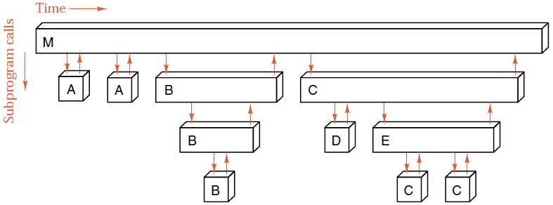
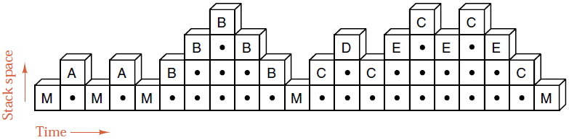
Stack Frames (栈帧)
栈帧(stack frame) / 活动记录(activation record)——为每个调用函数分配的临时存储区域，包括返回地址、调用参数、局部变量等。
函数嵌套调用——函数按“后进先出”次序；执行函数所使用的临时存储区域也具有“后进先出”的特性；于是调用记录必须用“堆栈”保存。

Slide 14
Stack Frames
When a program calls a subprogram, the system:
Store returning location and parameters;
Allocate storage for all the local variables.
Then the control is passed to the subprogram.
(i.e., The activation record is pushed into the stack)
When the subprogram is finished, the system:
Return the result of the subprogram;
Release the storage allocated for the subprogram;
The control is passed to the caller and execution starts at the returning address.
(i.e., The activation record for the function is popped out)
A function may call itself. There is no difference between this recursive call and other function calls.

Slide 15
When to Use Recursion
If time and space is not an issue, then recursive version is much easier to understand and preferred.
If duplicate tasks are involved, then data structure other than stacks will be appropriate.
Recursion can always be replaced by iteration and stacks. But no point to do it if not necessary.

Slide 16
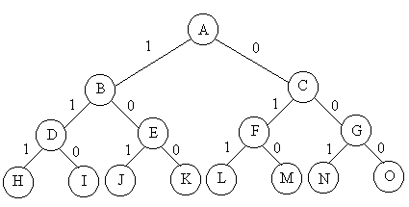
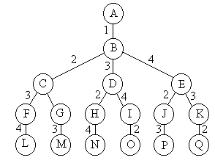
Generating Subsets and Permutations
Enumerating all subsets take O(2^{n})
Enumerating all permutations take O(n!)
void backtrack(int t)
{
if (t>n) output(x);
else
for (int i=t;i<=n;i++) {
swap(x[t], x[i]);
if (legal(t)) backtrack(t+1);
swap(x[t], x[i]);
}
}
void backtrack(int t)
{
if (t>n) output(x);
else
for (int i=0;i<=1;i++) {
x[t]=i;
if (legal(t)) backtrack(t+1);
}
}

Slide 17
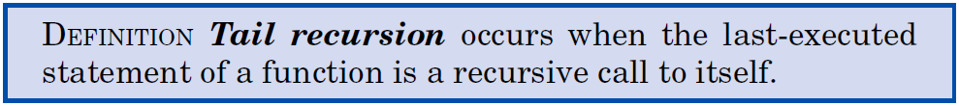
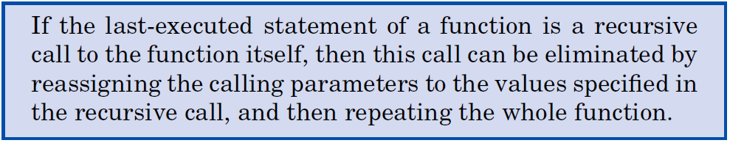
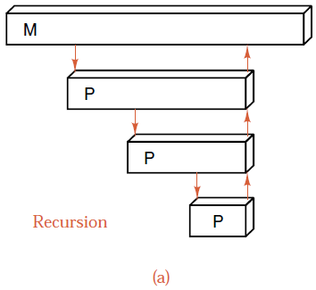
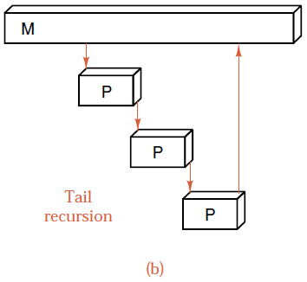
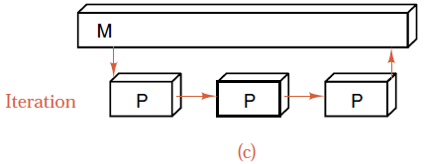
Tail Recursion

Slide 18
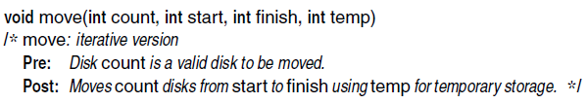
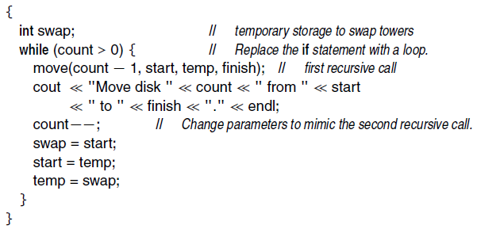
Hanoi Without Tail Recursion
tail recursion

Slide 19

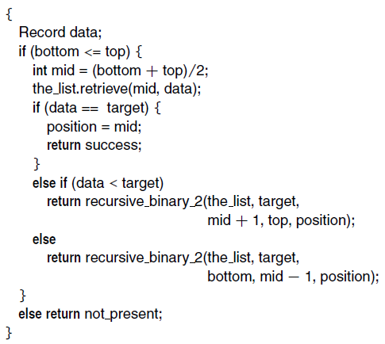

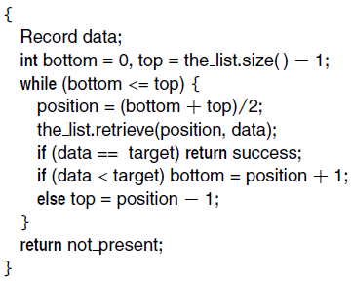
Binary Search With/Without Tail Recursion
tail recursion
tail recursion

Slide 20
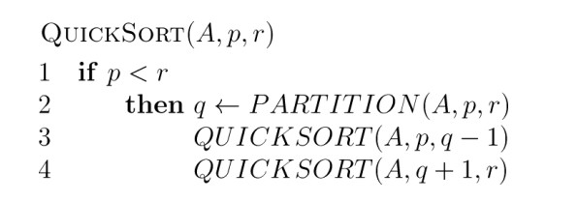
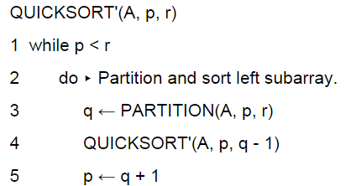
Quicksort With/Without Tail Recursion
tail recursion
Notes:
goto

Slide 21
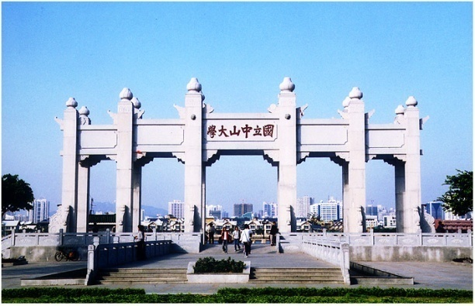
Thank you!

